Slide 1
Presidential Candidate Sentiment Analysis
Sentiment Analysis over articles from top news sources to measure the amount of positive, negative, and neutral content each source has for each presidential candidate.
By: Nolan Arendt, Jason Rhodeman, Bryan Crigger

Slide 2
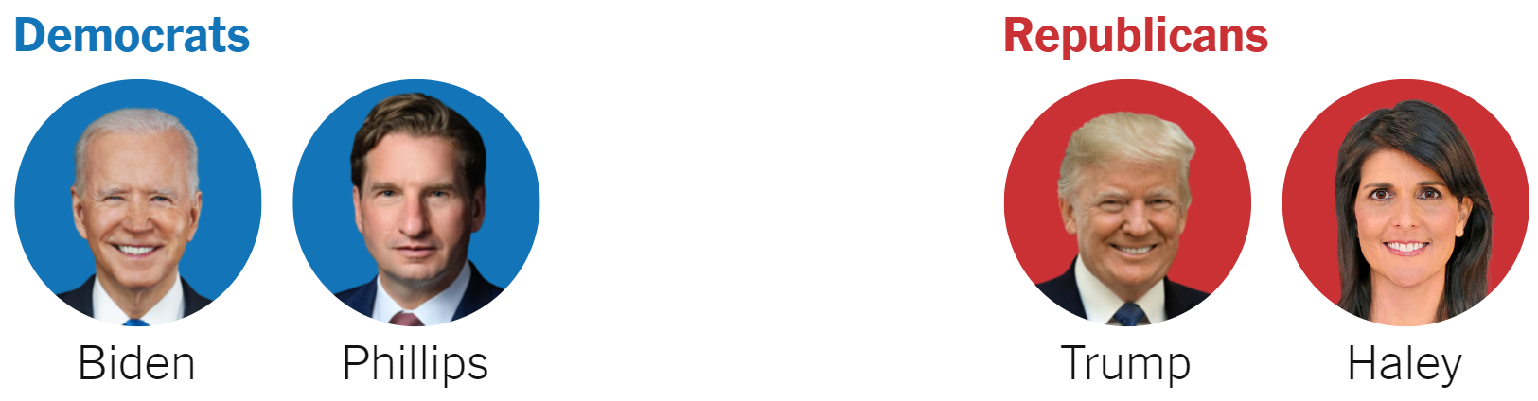
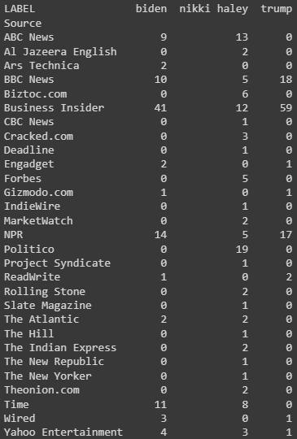
Candidates & Data
Can we predict which news source wrote each article about the candidate?
Utilize sentiment analysis and the text within the article as key indicators.
Notes:
Choosing to focus on the top presidential candidates: Biden, Trump, and Nikki Haley

Slide 3
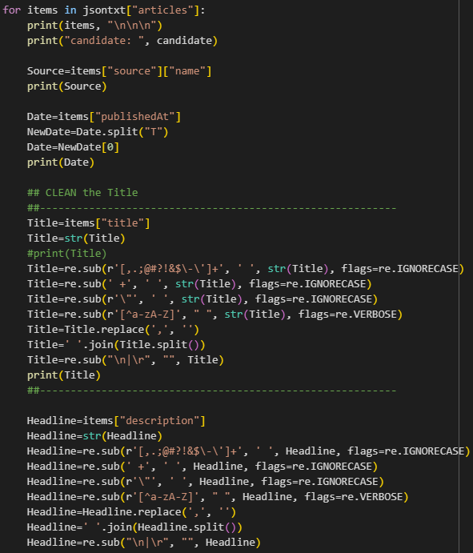
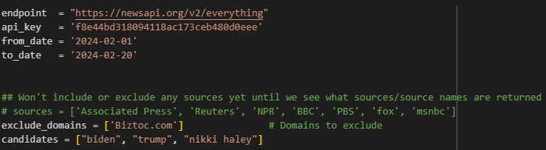

API Call

Slide 4
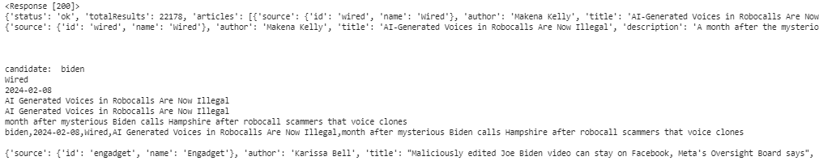
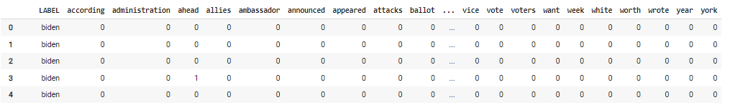
Data Acquisition & Vectorization

Slide 5
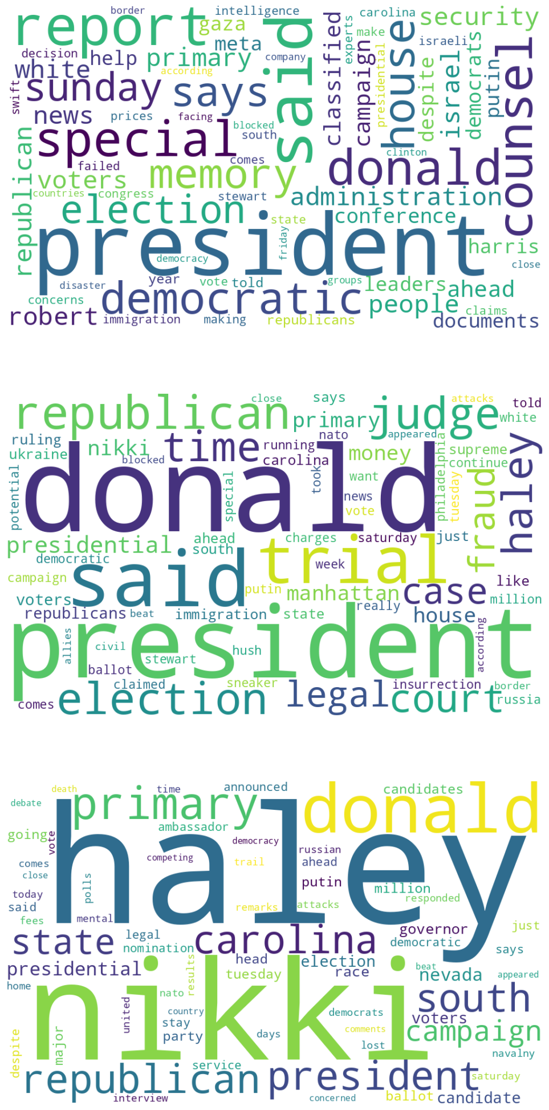
Word Clouds
Trump
Biden
Nikki Haley

Slide 6
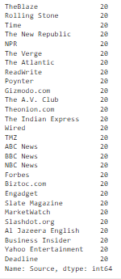
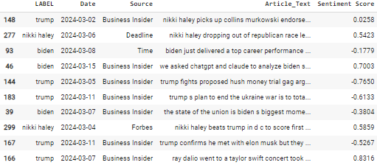
Balancing of Data + Sentiment Analysis
Applied VADER Sentiment Analysis to the Article Text column
Balanced the dataset to equal sample sizes (20) for each News Source using oversampling / undersampling

Slide 7
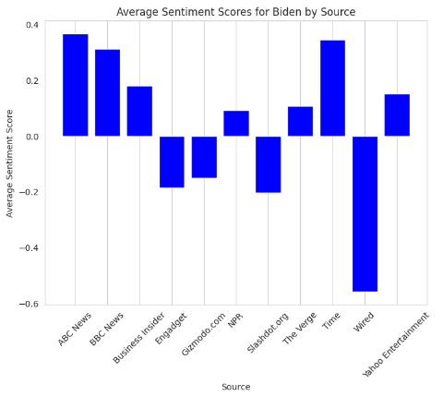
EXPLORATORY DATA ANALYSIS (EDA)

Slide 8
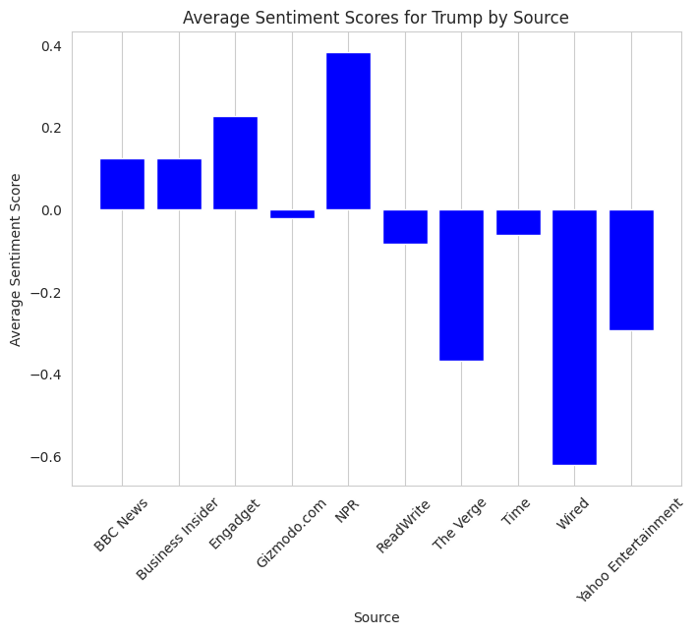
EXPLORATORY DATA ANALYSIS (EDA)

Slide 9
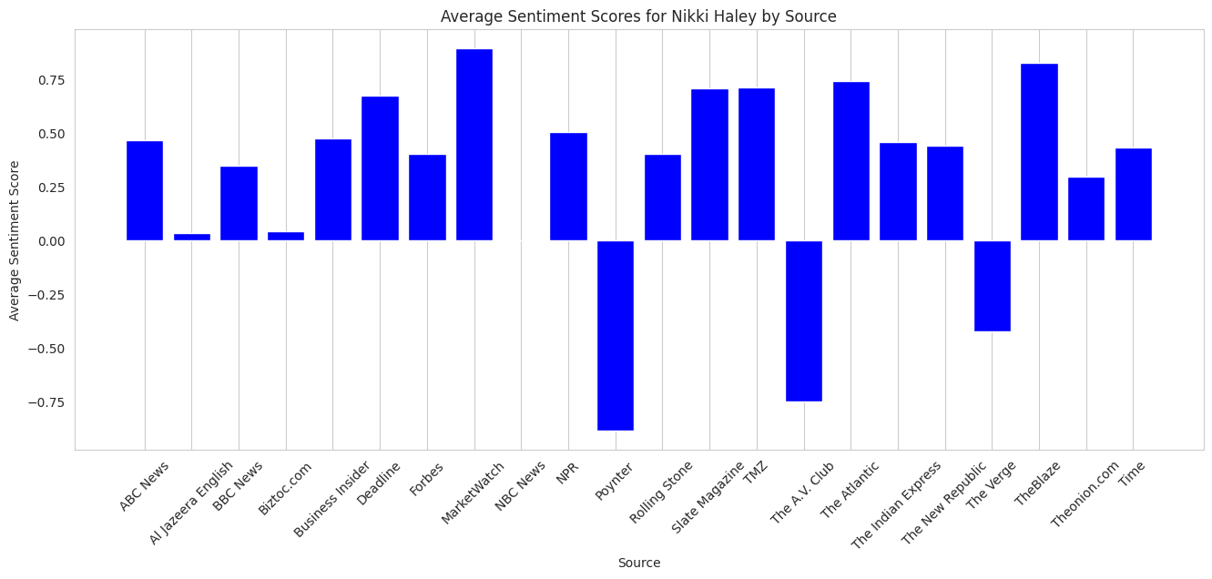
EXPLORATORY DATA ANALYSIS (EDA)

Slide 10
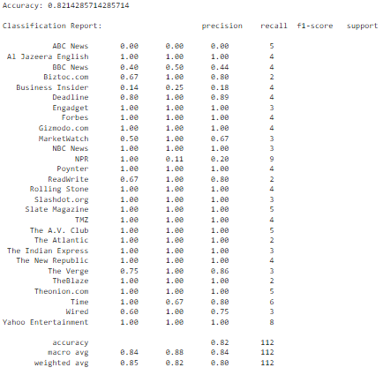
Models: Logistic Regression
Logistic Regression model achieved an overall accuracy of roughly 82.14% on the test dataset.
The model utilized a combination of TF-IDF vectorization for text data and one-hot encoding for categorical labels.
Performance varied across different news sources.
The model’s macro and weighted average scores are relatively high, indicating a good performance but suggests opportunities for model improvements.

Slide 11
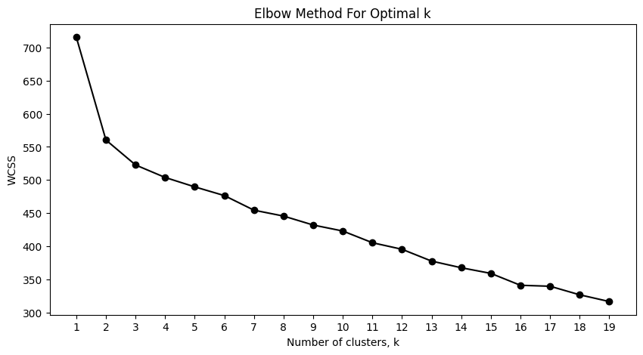
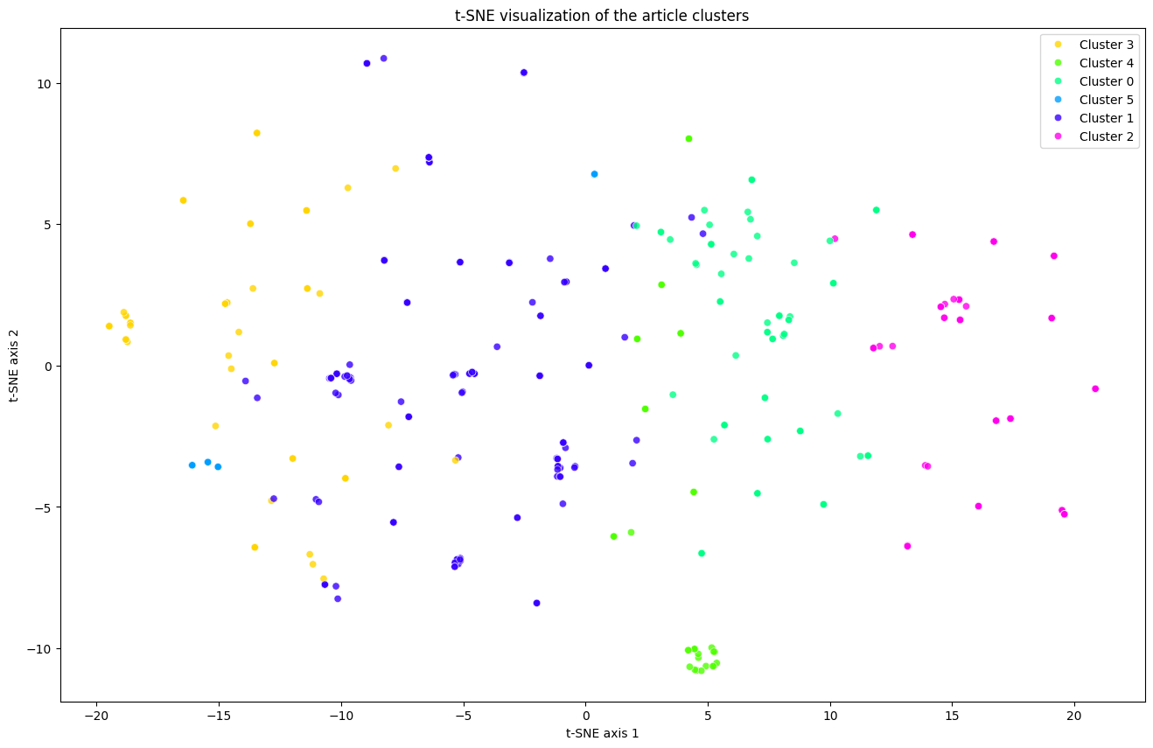
Models: K Means Clustering
Utilized the Elbow method to identify optimal number of clusters (6).
Clusters were analyzed for average sentiment score, with Cluster 3 showing the highest average sentiment score, and Cluster 2 the lowest, indicating more negative content.

Slide 12
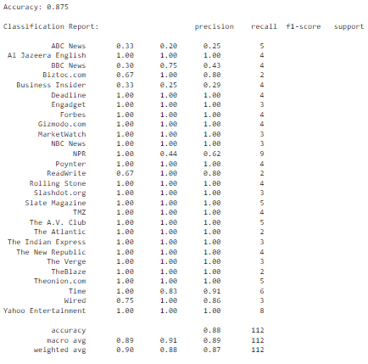
Models: Random Forest
The Random Forest model achieved an accuracy of 87.5% on the test set, representing a strong predictive capability.
A preprocessor was used in the pipeline to transform the data, combining TF-IDF vectorization for text and one-hot encoding for categorical variables, along with sentiment scores.
The model's precision, recall, and F1-score across different news sources showed variation, with several sources being perfectly predicted (F1-score of 1.00) and others having room for improvement.
The macro and weighted average scores for precision, recall, and F1-score were all high, indicating that the model's performance is robust across diverse news sources.

Slide 13
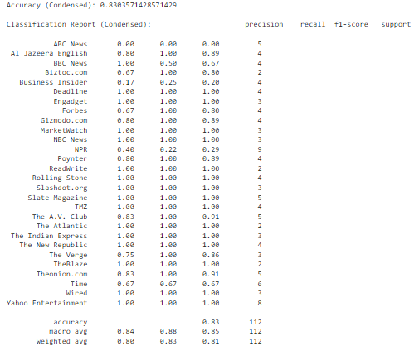
Models: Decision Tree
The Decision Tree model with a maximum depth of 30 exhibited an accuracy of approximately 83.04% on the test dataset, which is indicative of a solid prediction capability for the given task.
The classification report reveals a range of performance metrics across different news sources, with some sources having high precision and recall, while others, like ABC News, showed a precision and recall of 0.00, indicating a need for improvement in classifying these articles.
Overall, the model’s precision, recall, and F1-score demonstrate that while the Decision Tree can predict certain categories with high accuracy, there are other categories where it does not perform as well, suggesting potential areas for model refinement.

Slide 14
CONCLUSIONS

